Slide 1

Deep Learning Content-Aware Image Restoration
Anna Sim
4D CELL Biology Lab

Slide 2
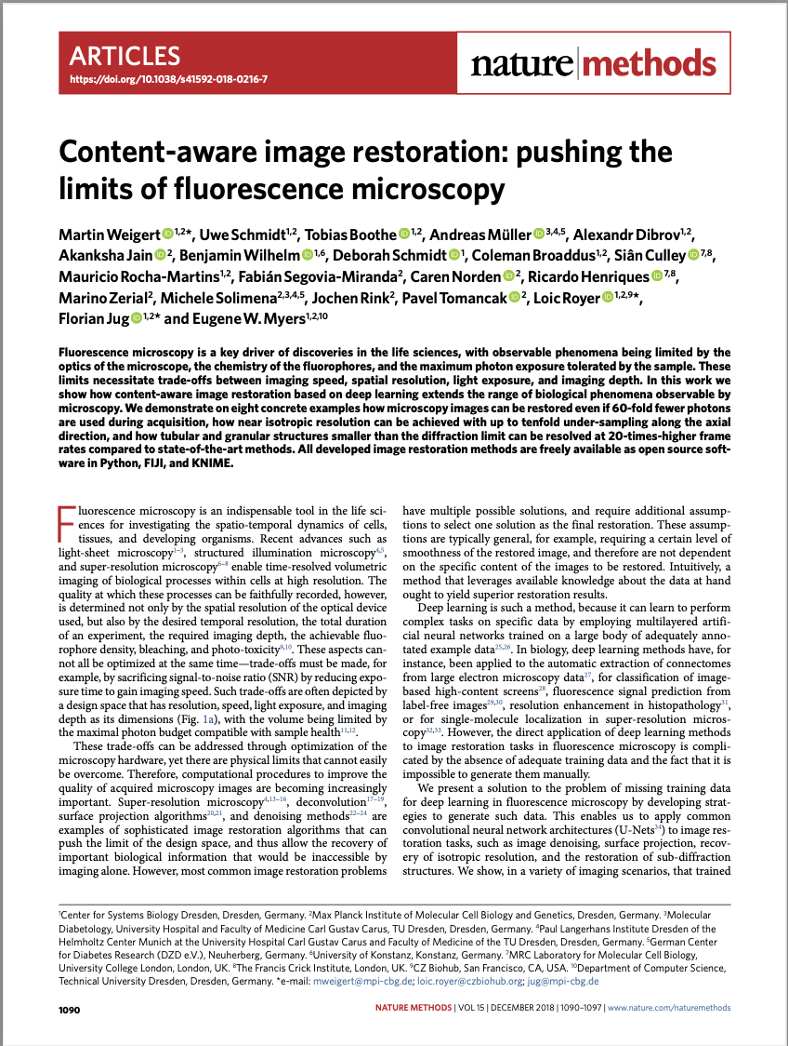
Background
Nature | Methods
Martin Weigert et al.
Max Planck Institute of Molecular Cell Biology and Genetics, Dresden, Germany.
Published: 26 November 2018

Slide 3
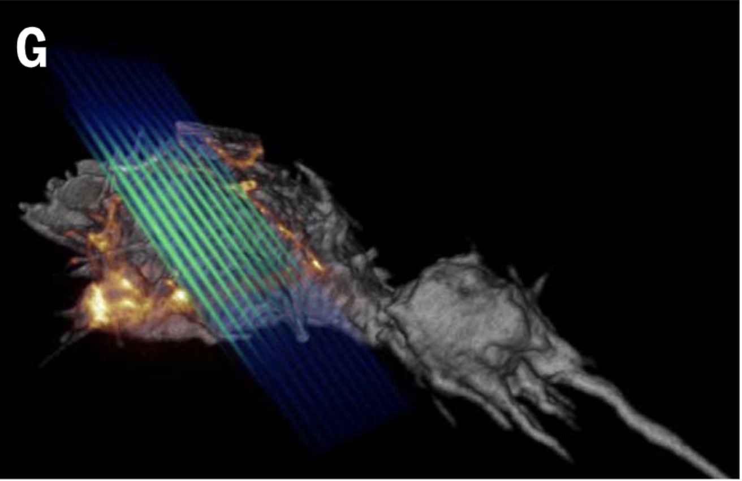
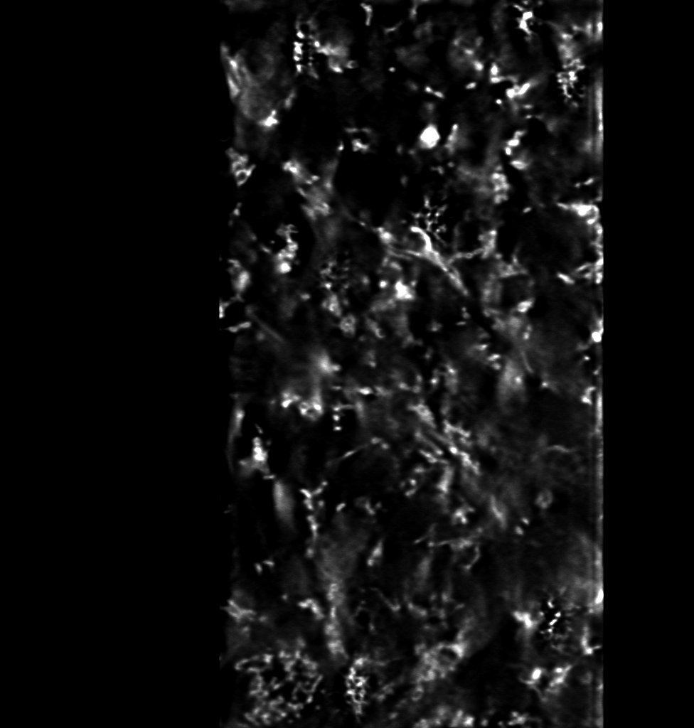
Background
Spatial Resolution & Temporal Resolution
Goals:
High spatial resolution
Prolong time of the experiment
Required Imaging Depth
Addressing Bleaching and Toxicity
x
y
z
Chen, B. C., Legant, W. R., Wang, K., Shao, L., Milkie, D. E., Davidson, M. W., ... & Betzig, E. (2014).
Lattice light-sheet microscopy: imaging molecules to embryos at high spatiotemporal resolution. Science, 346(6208), 1257998.

Slide 4
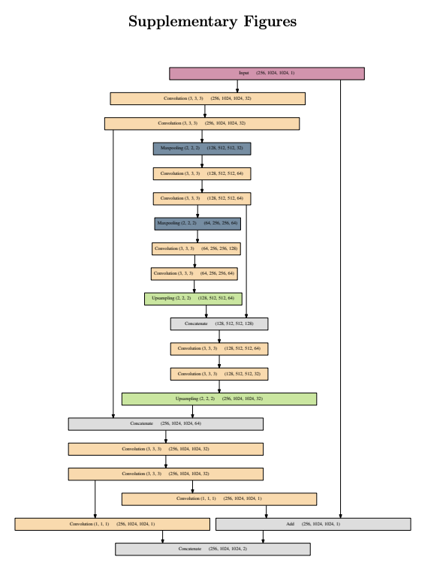
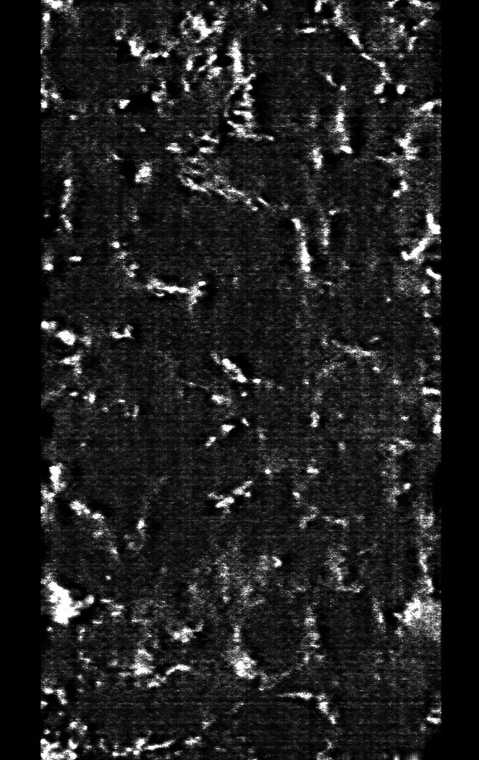
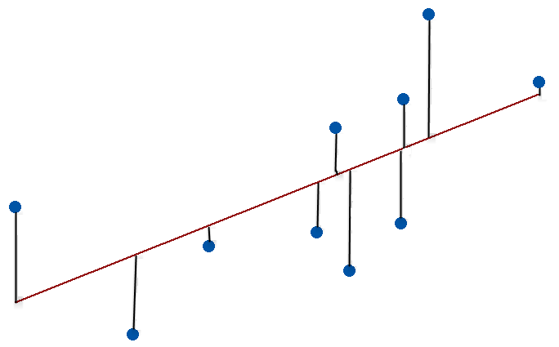
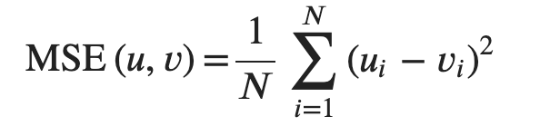
Background
Deep Learning methods are based on:
Large number of Annotated Examples Mathematical Models Artificial Neural Network

Slide 6
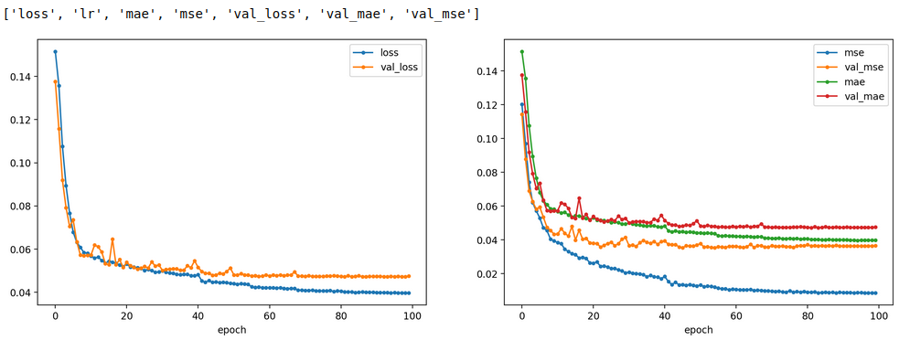
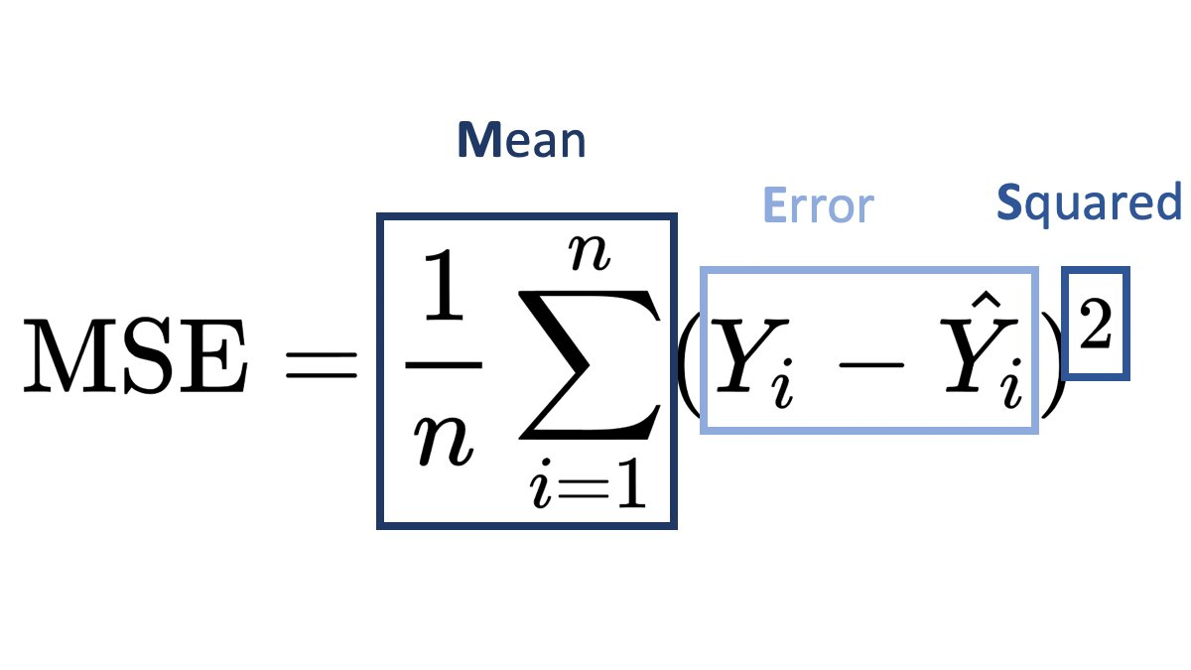
Background
Deep Learning methods are based on:
Mathematical Models

Slide 7
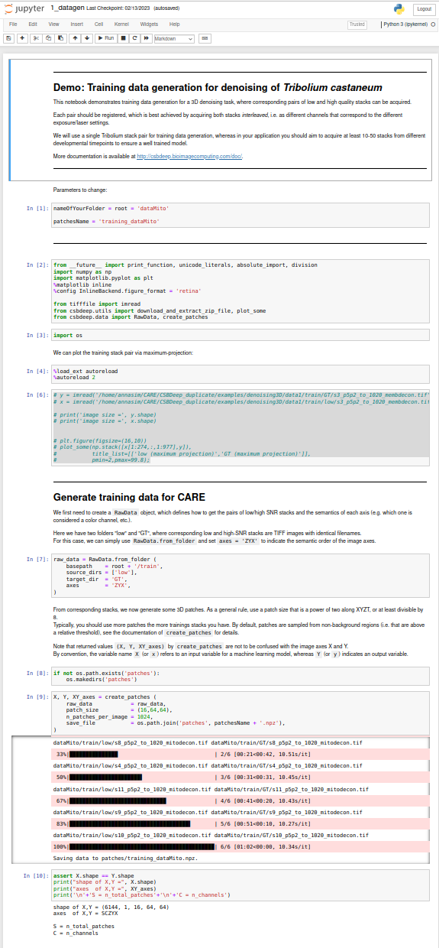
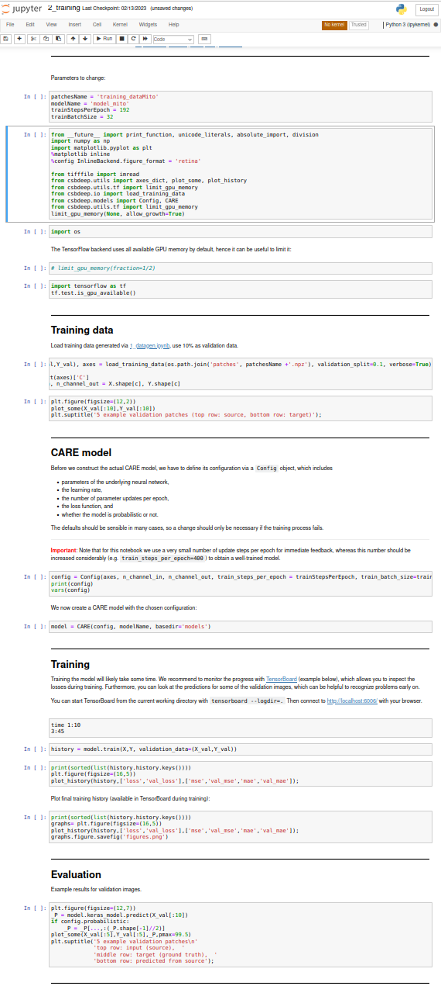
Three essential parts of any Machine Learning Model
Data Generation
Training
Prediction

Slide 8
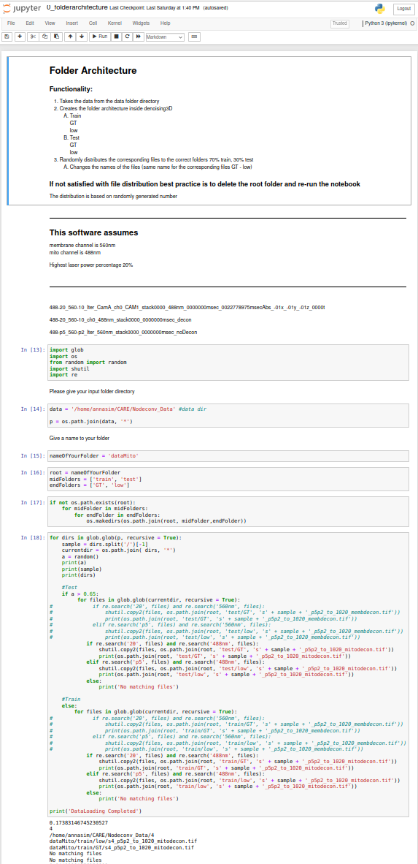
Three Four essential parts of any Machine Learning Model
Folder Architecture
Data Generation
Training
Prediction

Slide 9
Results
Three models trained:
PreProcessed Data
Raw Data
Raw Mito Data
Denoised Data
PreProcessed and Denoise Data
PreProcessed and Denoise Data

Slide 10

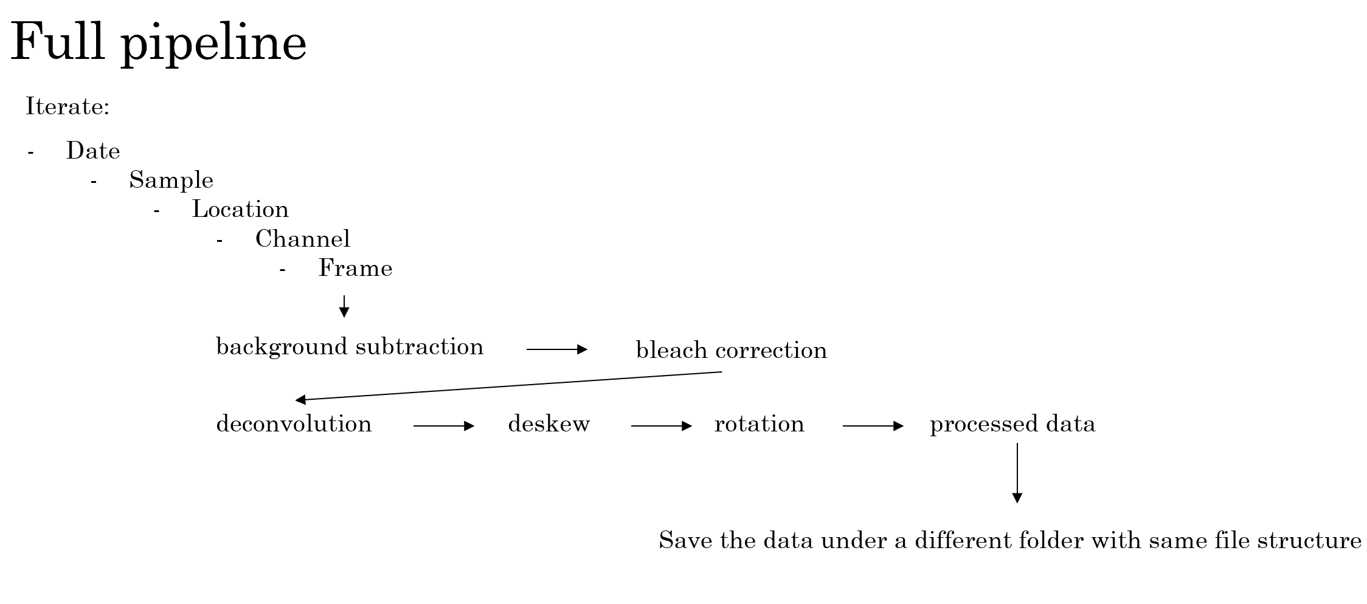
Results
Zachary Wang

Slide 11
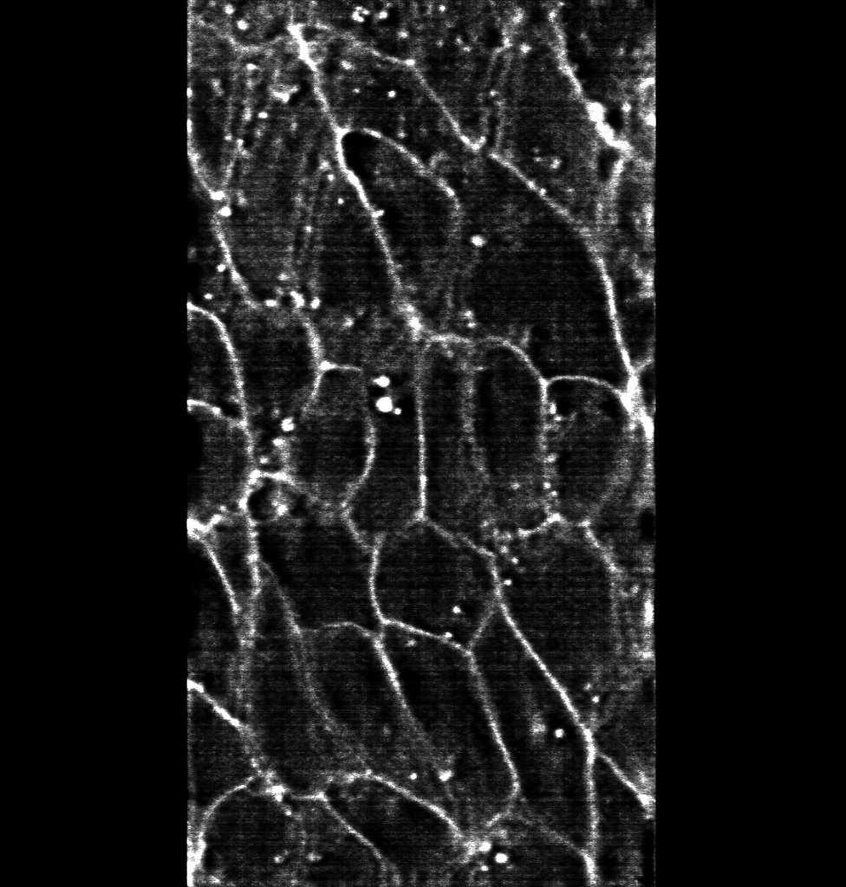
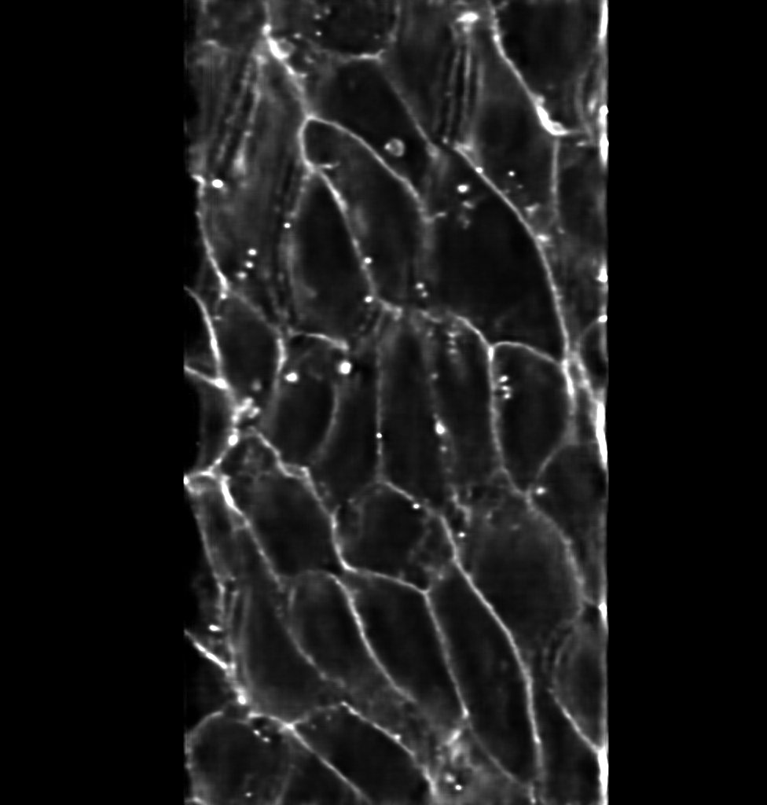
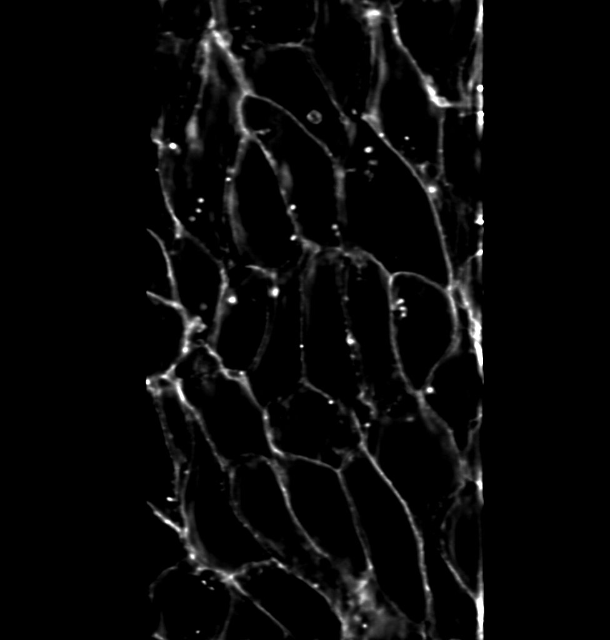
Model_1.0 PreProcessed Data – Denoised Data
sample 10
Membrane
Low – Laser Power (0.5 % | 0.2%)
Prediction
GT – Laser Power (20% | 10%)

Slide 12
Model Prediction

Slide 13
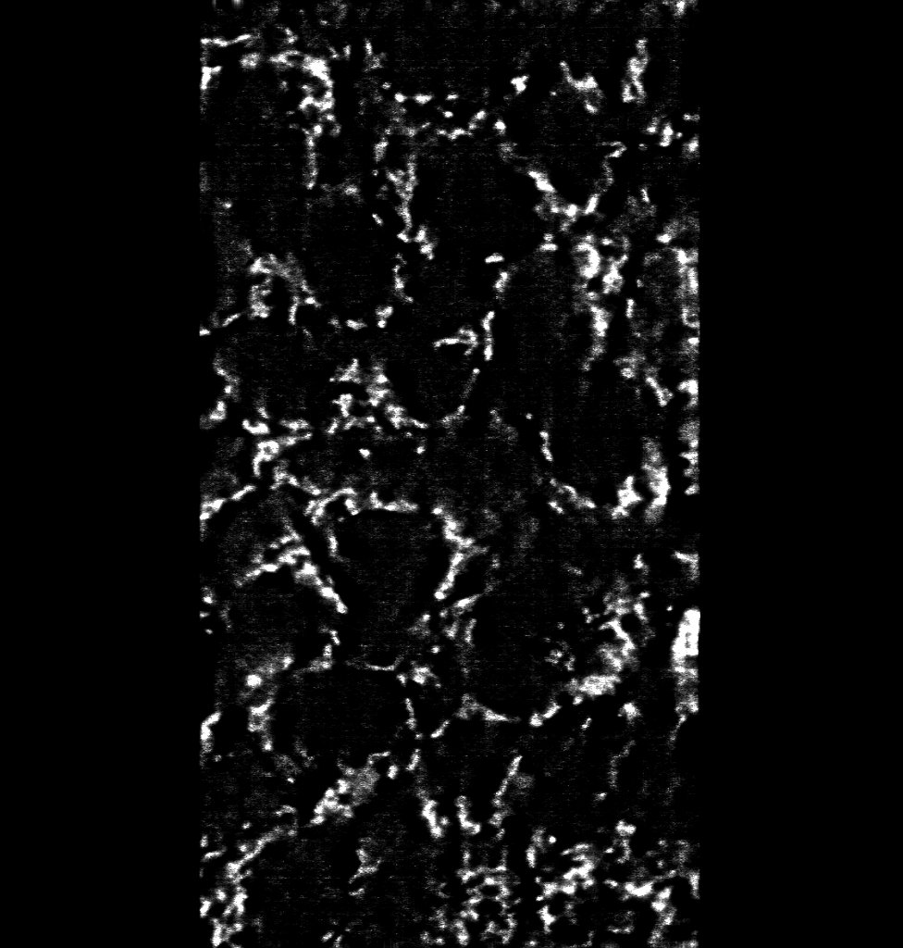
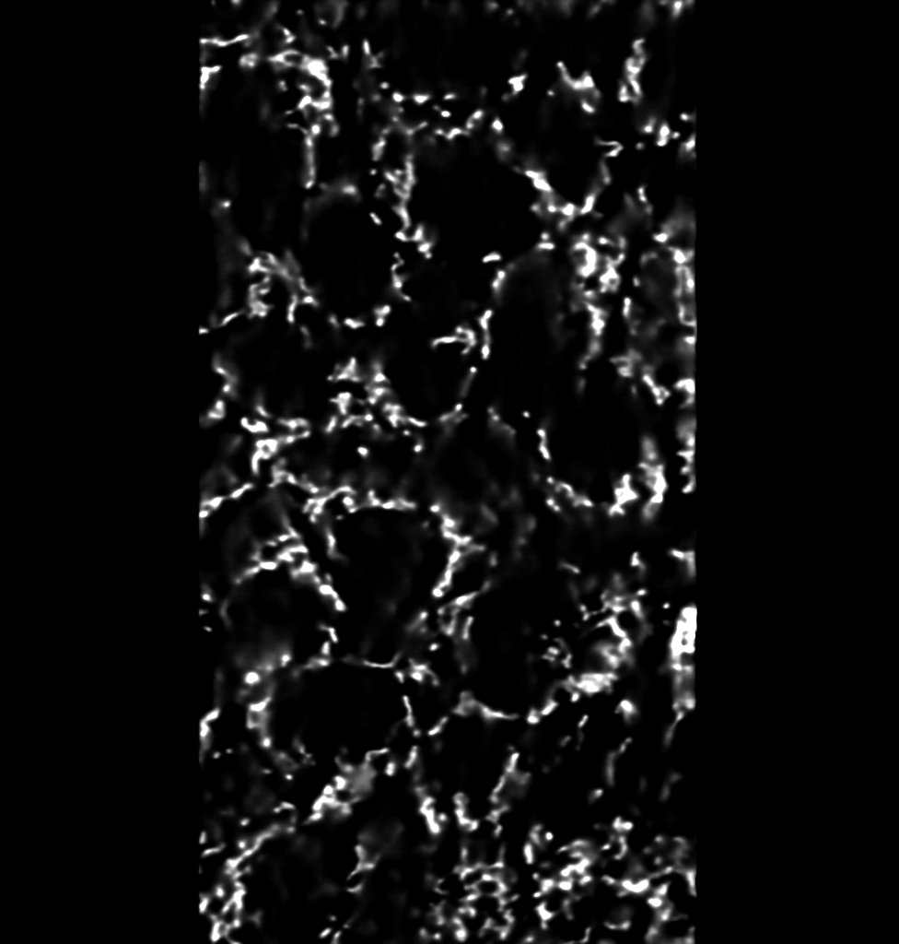

Model_1.0 PreProcessed Data – Denoised Data
sample 6
Mitochondria
Low – Laser Power (0.5 | 0.2)
Prediction
GT – Laser Power (20% | 10%)

Slide 14
Model Prediction

Slide 15
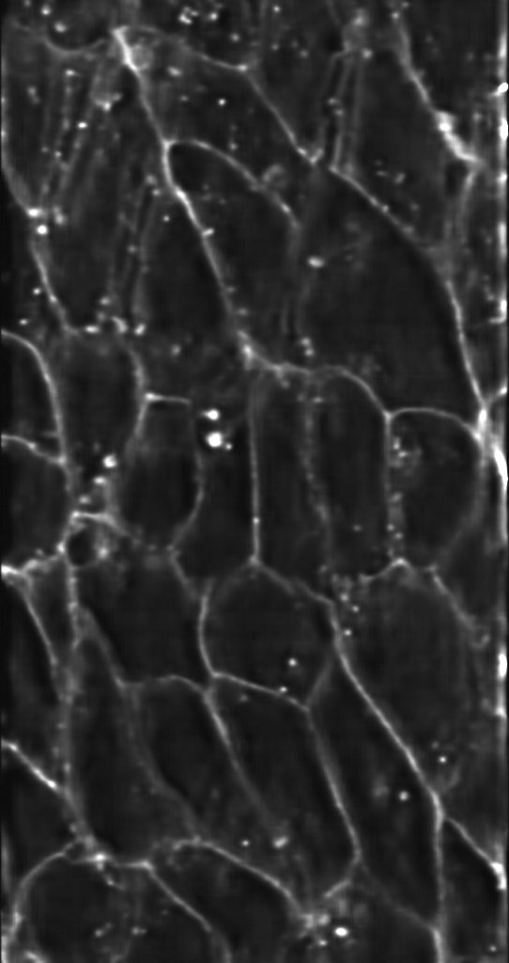
Model_1.1 Raw Data – Denoised Data
sample 10
Membrane
Low – Laser Power (0.5 | 0.2)
Prediction
GT – Laser Power (20% | 10%)

Slide 16
Model Prediction

Slide 17
Sample 10
Model 1.0
Model 1.1

Slide 18
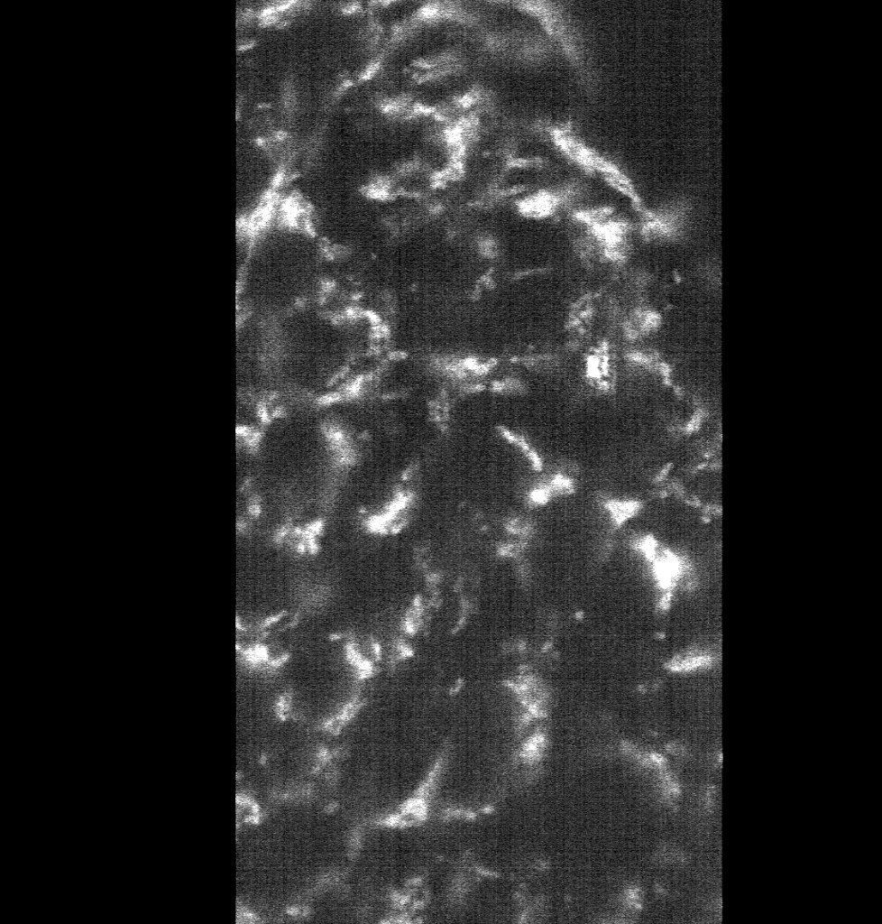
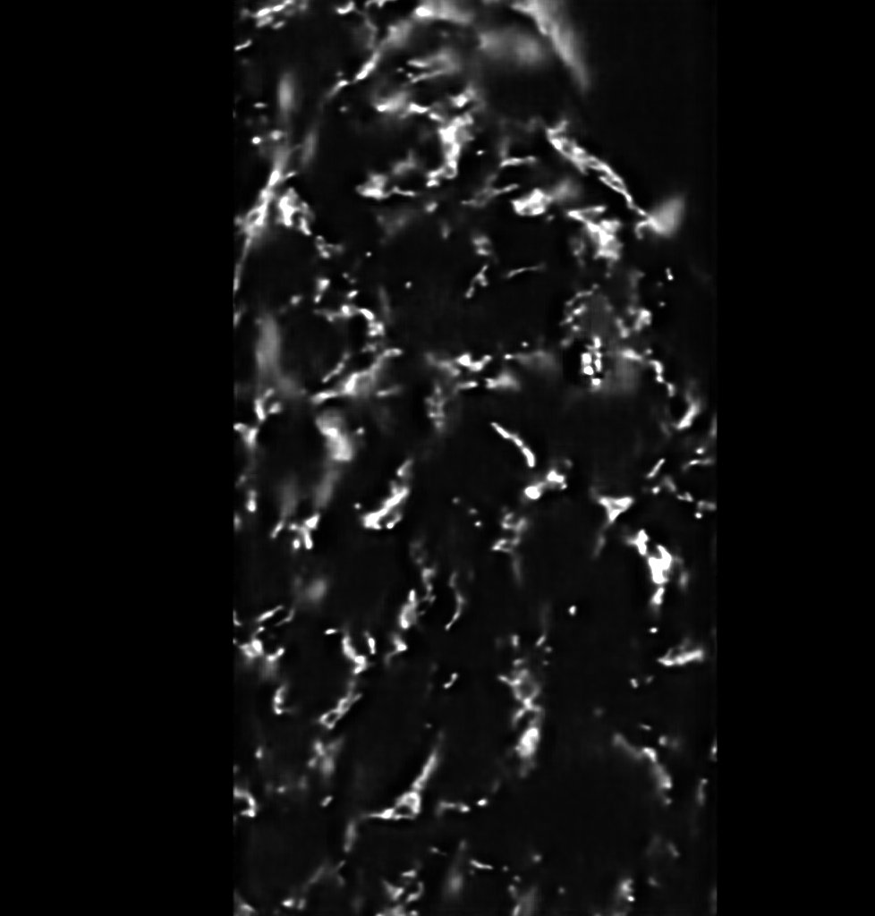
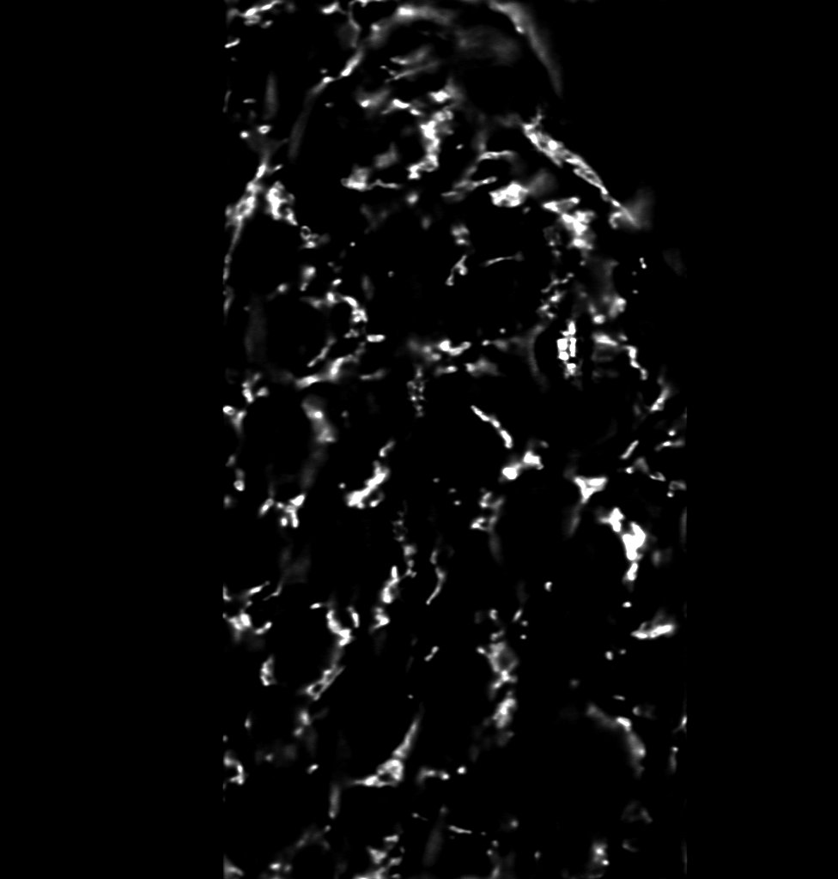
Model_1.1 Raw Data – Denoised Data
sample 8
Mitochondria
Low – Laser Power (0.5 | 0.2)
Prediction
GT – Laser Power (20% | 10%)

Slide 19
Model Prediction

Slide 20
Model 1.0
Model 1.1

Slide 21
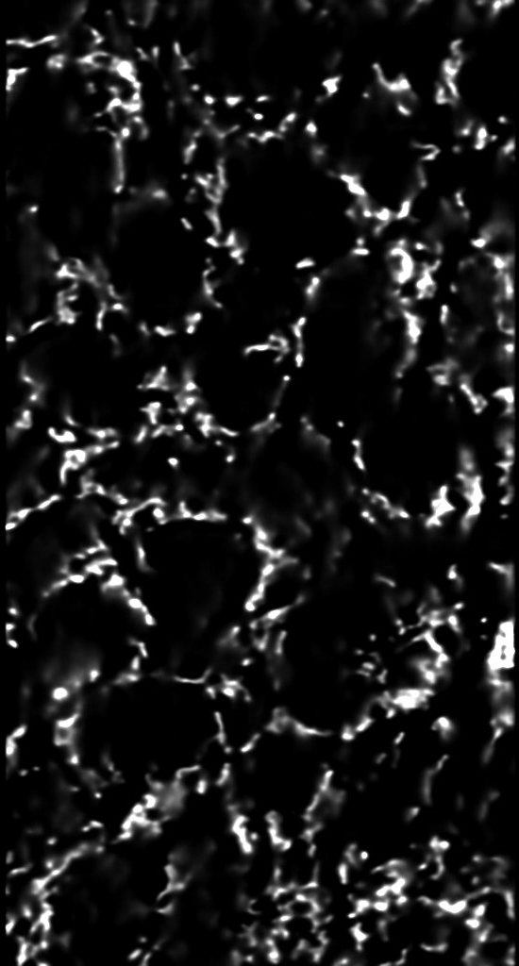
Model_Mito Raw Data – Denoised Data
sample 6
Mitochondria
Low – Laser Power (0.5 | 0.2)
Prediction
GT – Laser Power (20% | 10%)

Slide 22
Model Prediction

Slide 23
Model 1.0
Model 1.1
Model Mito
Sample 6
Sample 8
Sample 6

Slide 24
Model 1.0
Model Mito
Sample 6
Sample 6

Slide 25
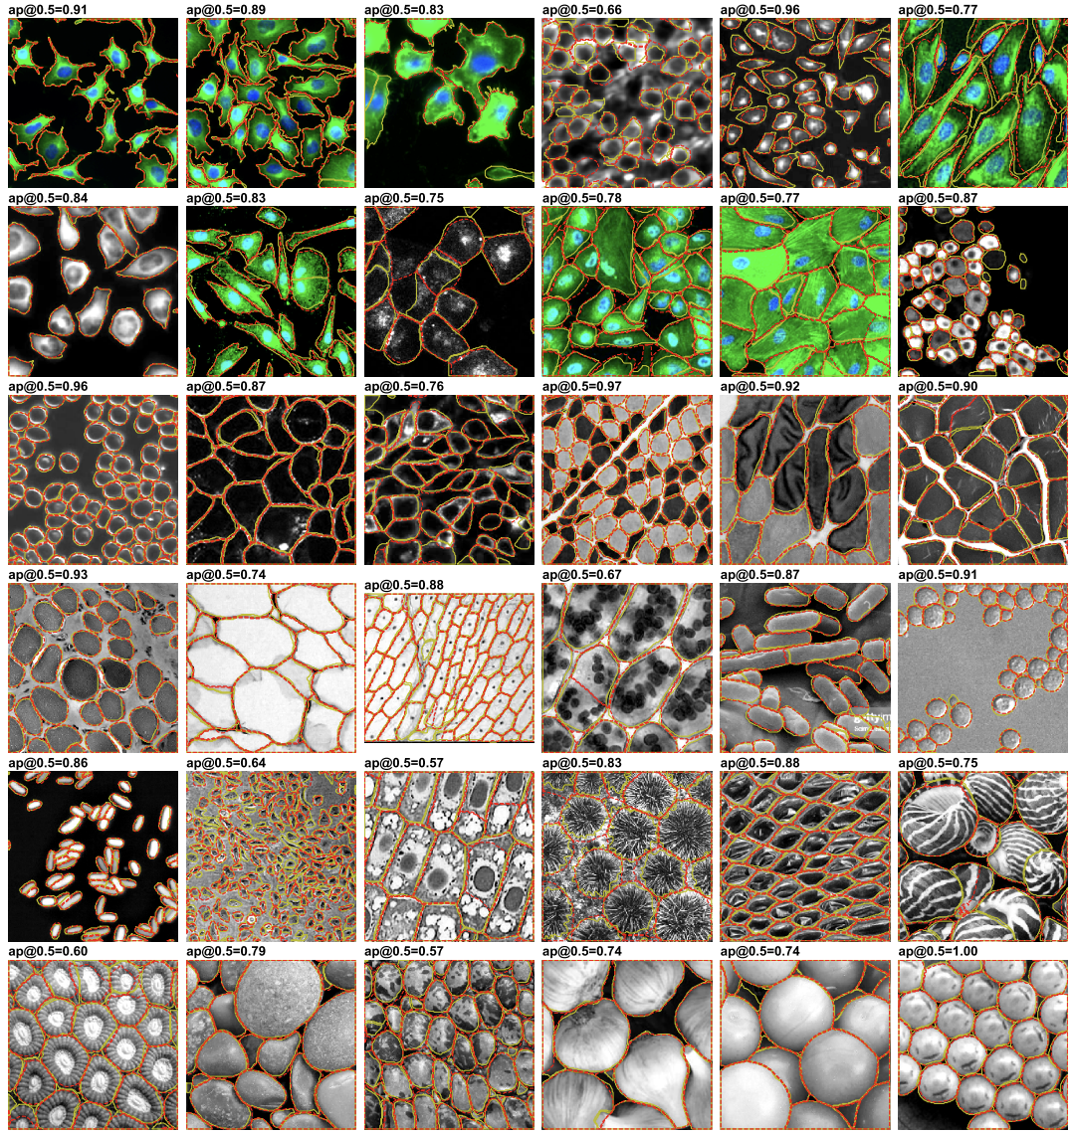
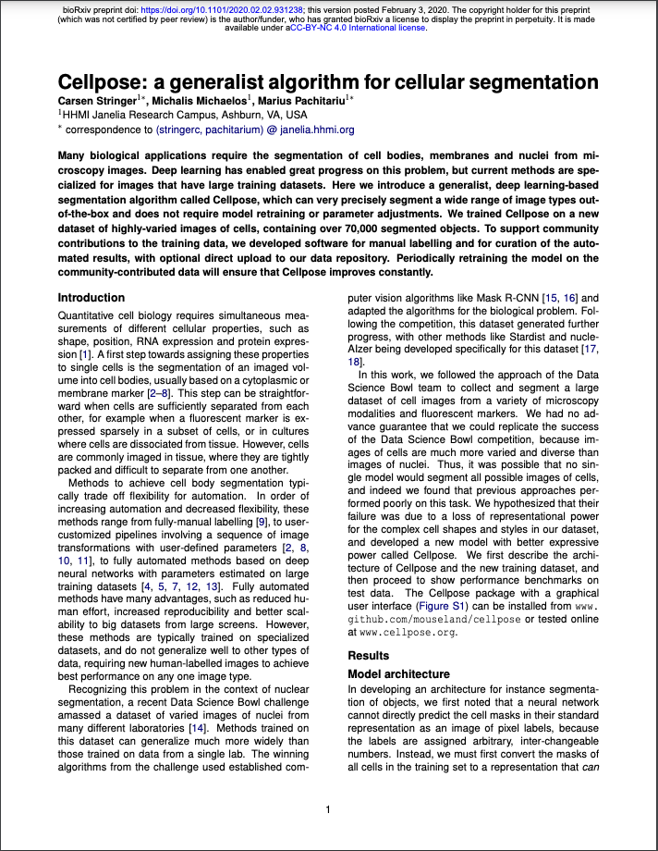
CARE | CellPose

Slide 26
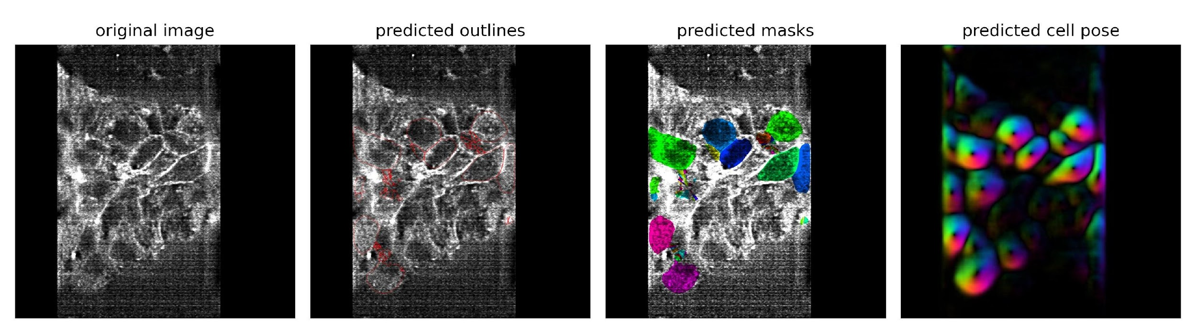
CARE | CellPose
Slice 98
Raw

Slide 27
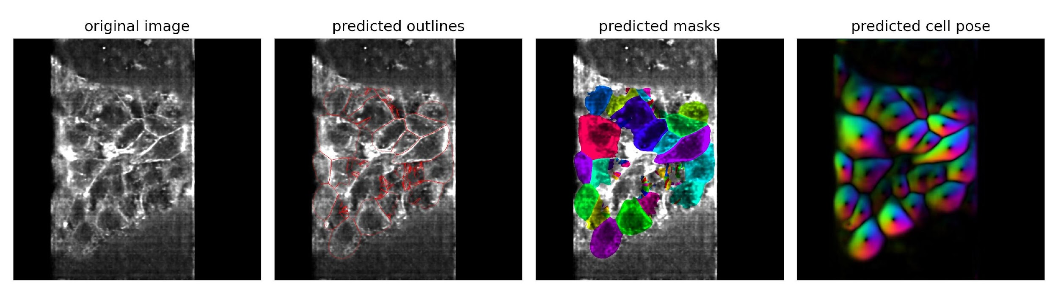
CARE | CellPose
Slice 98
Raw
CARE

Slide 28
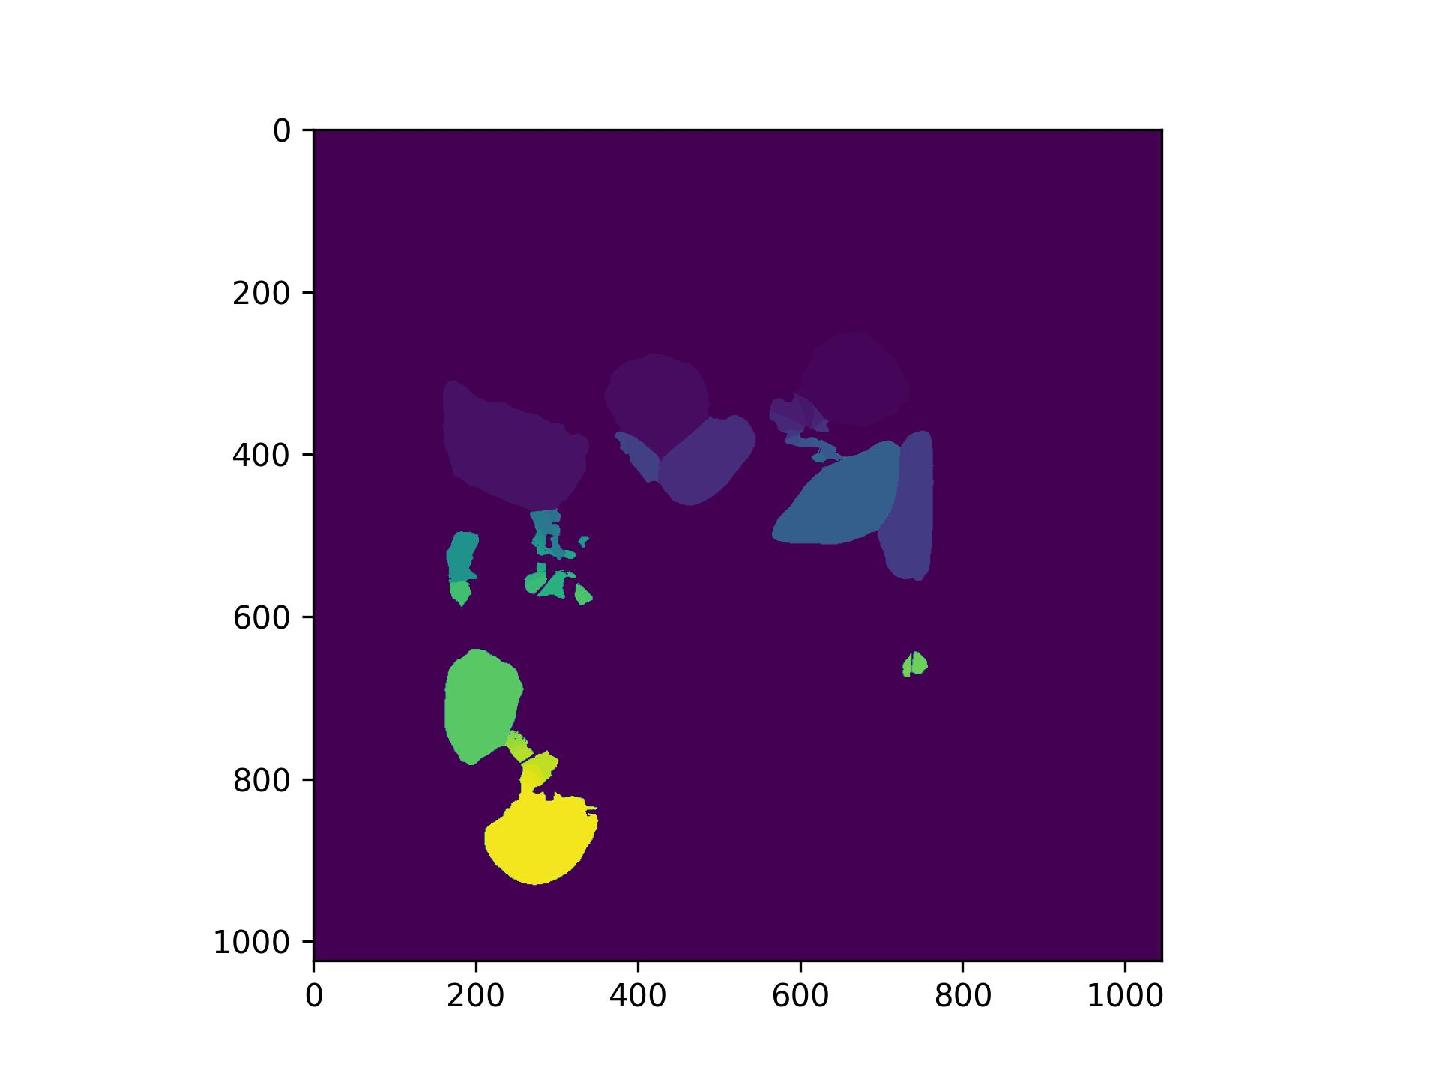
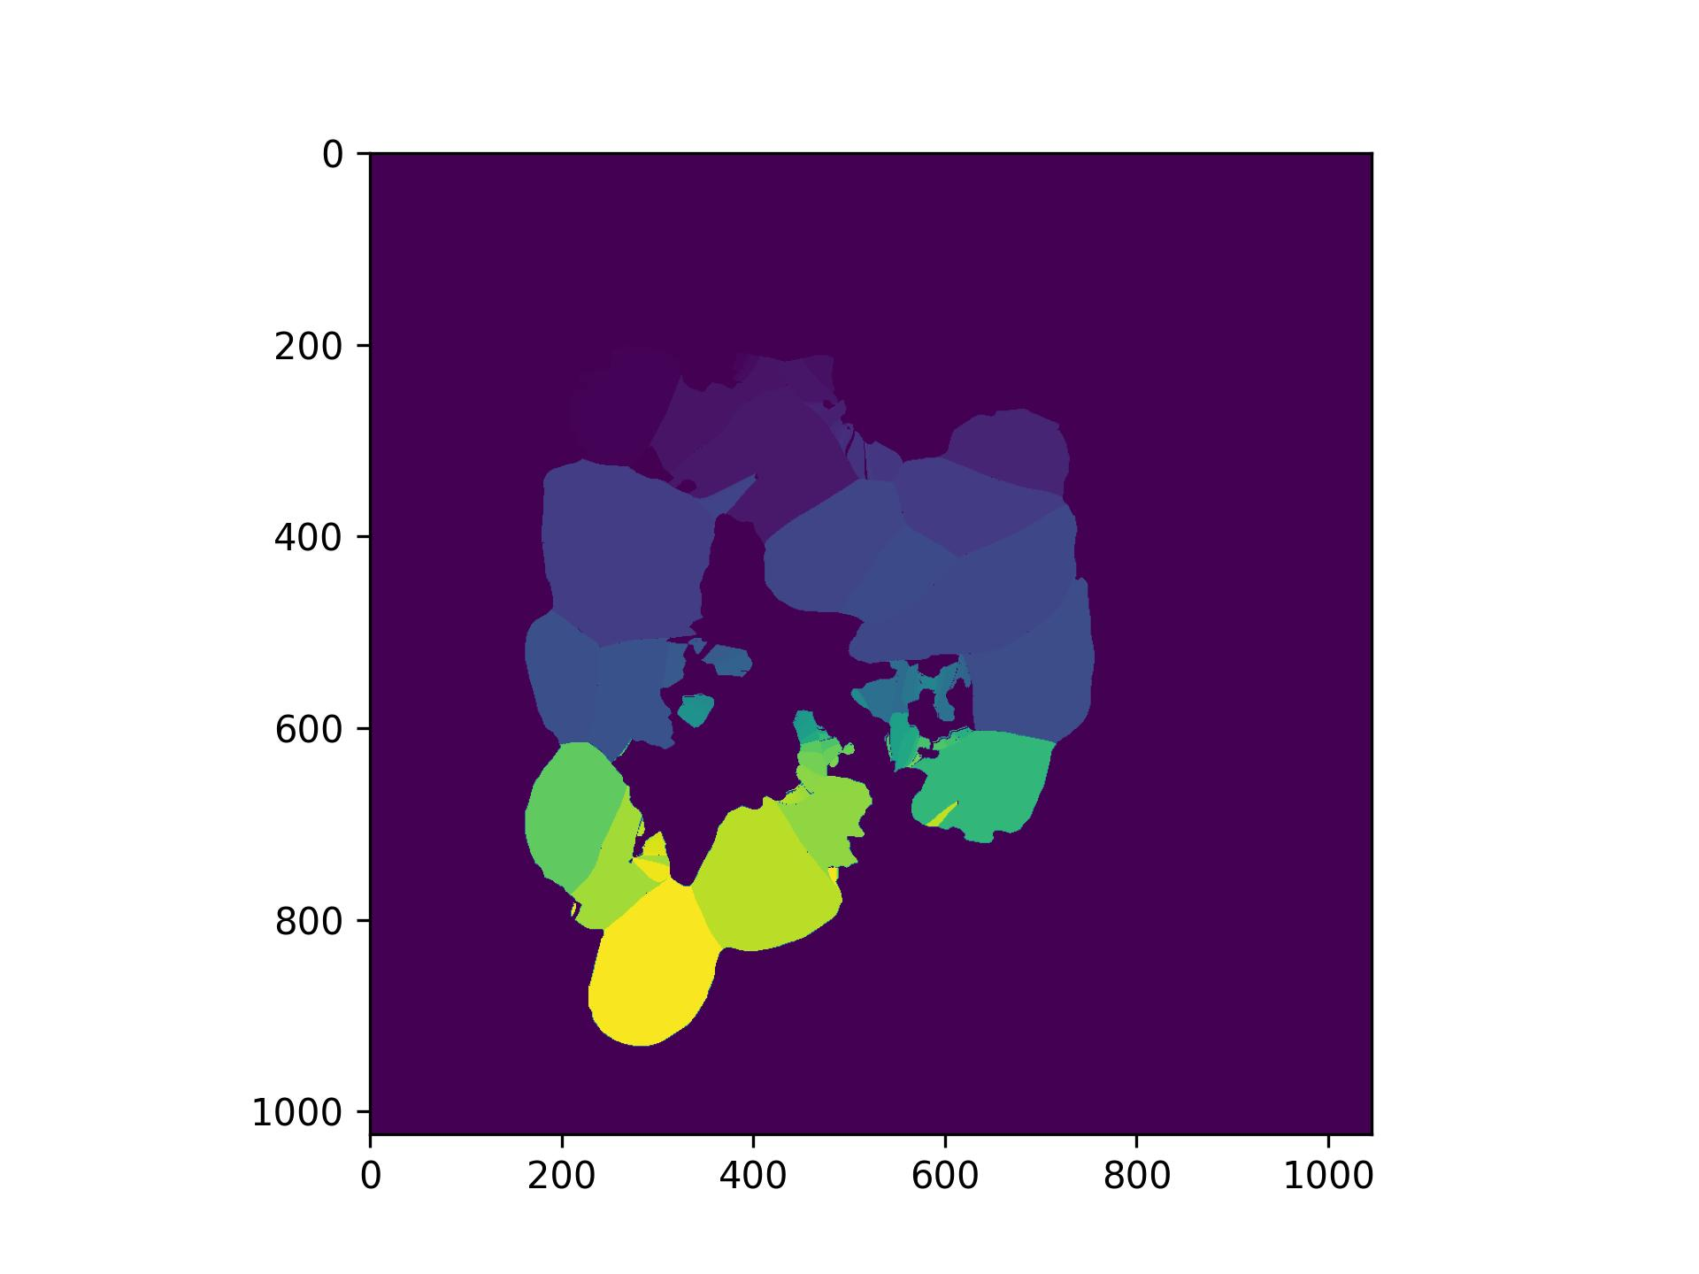
CARE | CellPose
Slice 98
Raw
CARE

Slide 29
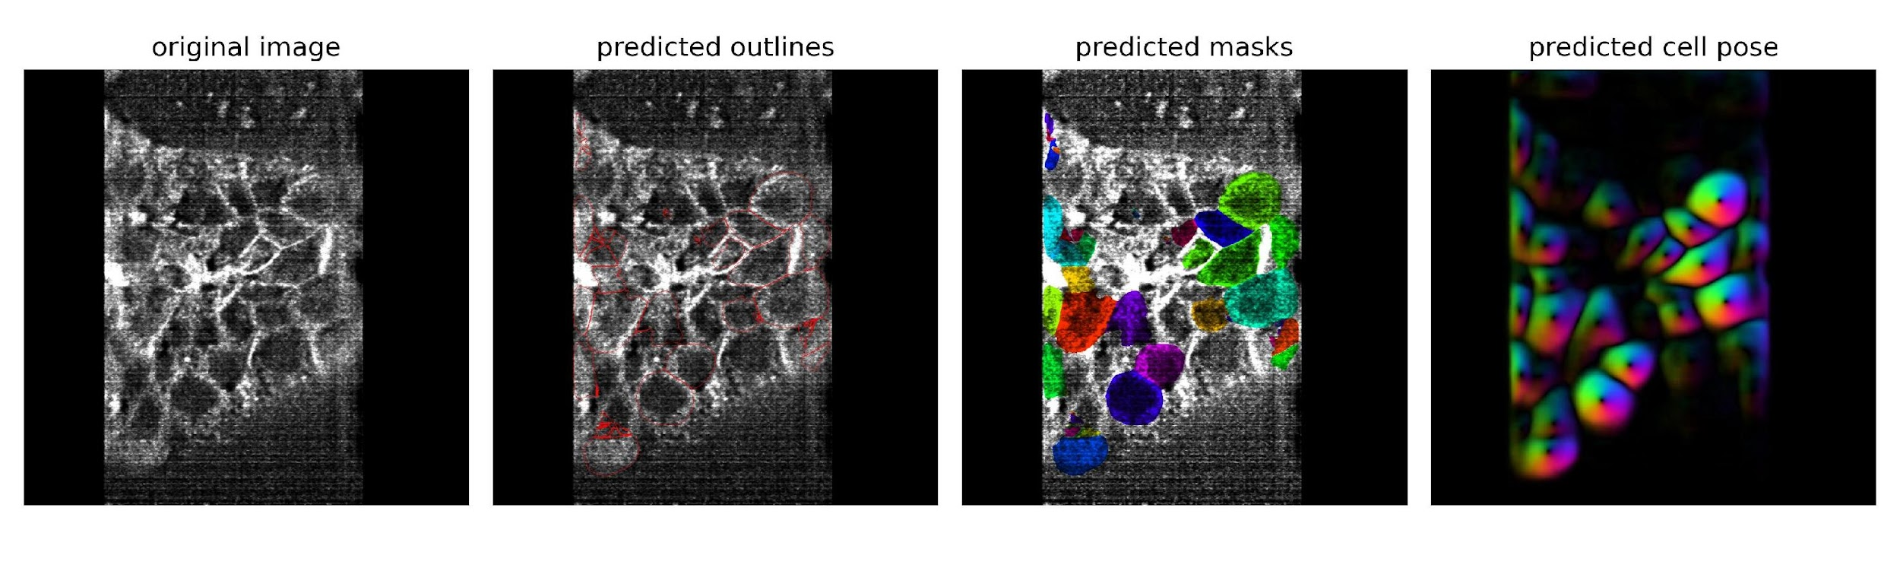
CARE | CellPose
Slice 117
Raw

Slide 30
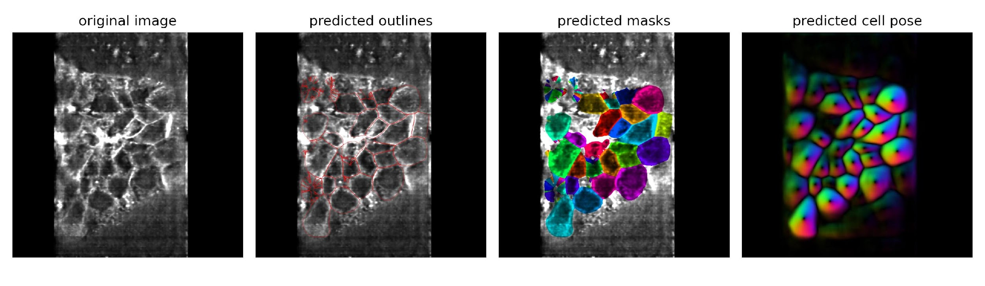
CARE | CellPose
Slice 117
Raw
CARE

Slide 31
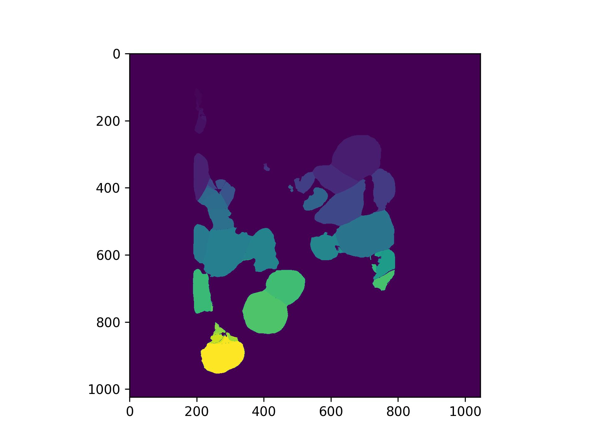
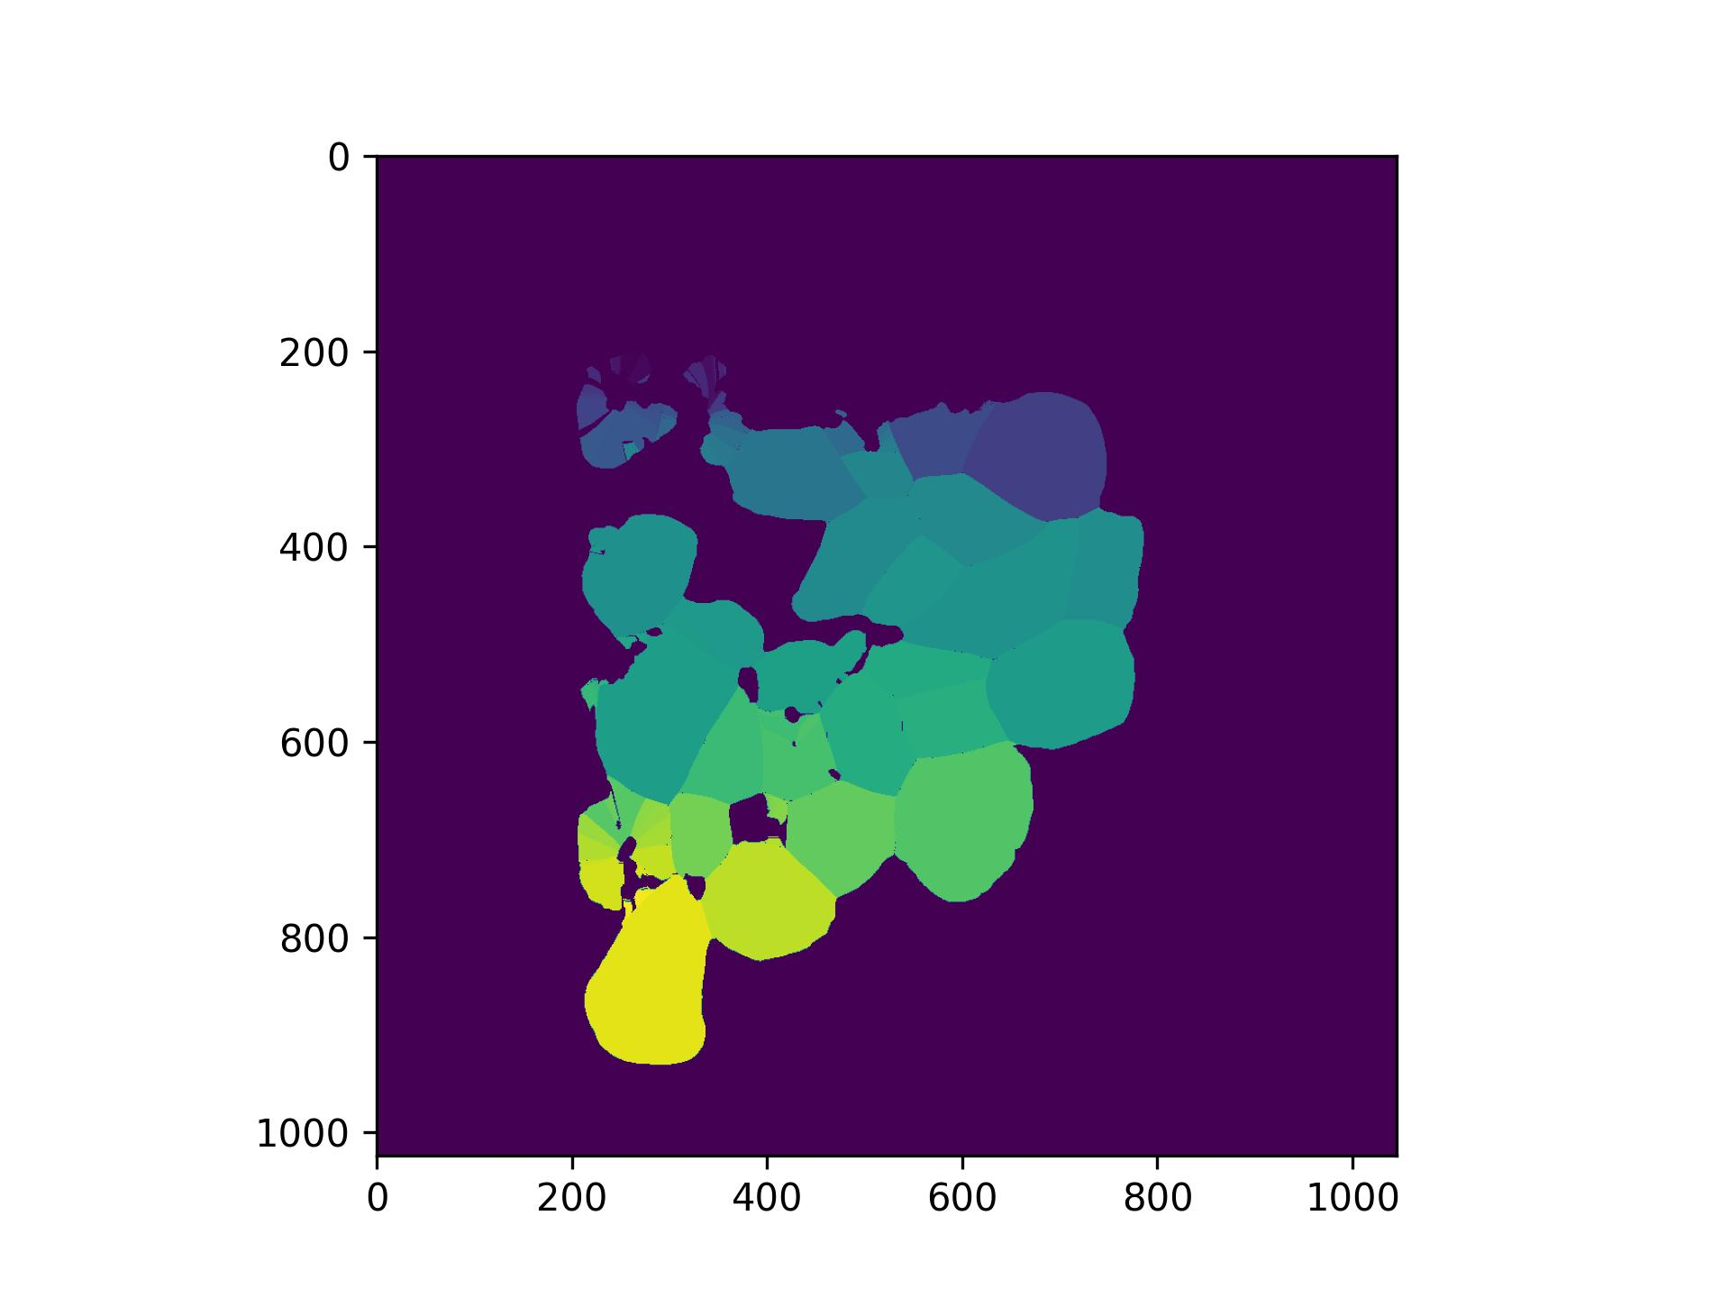
CARE | CellPose
Slice 117
Raw
CARE

Slide 32
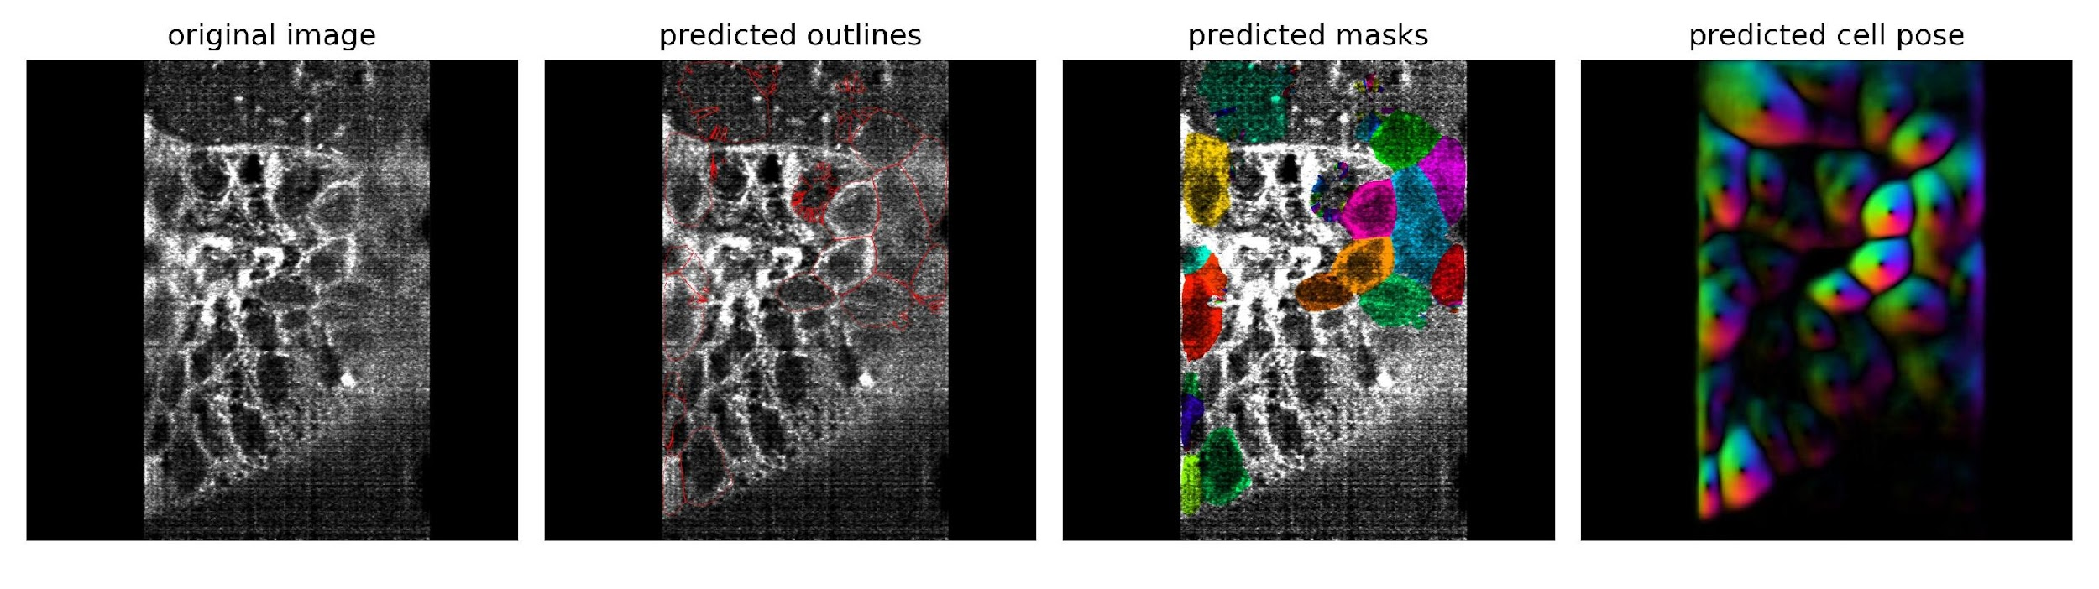
CARE | CellPose
Slice 150
Raw

Slide 33
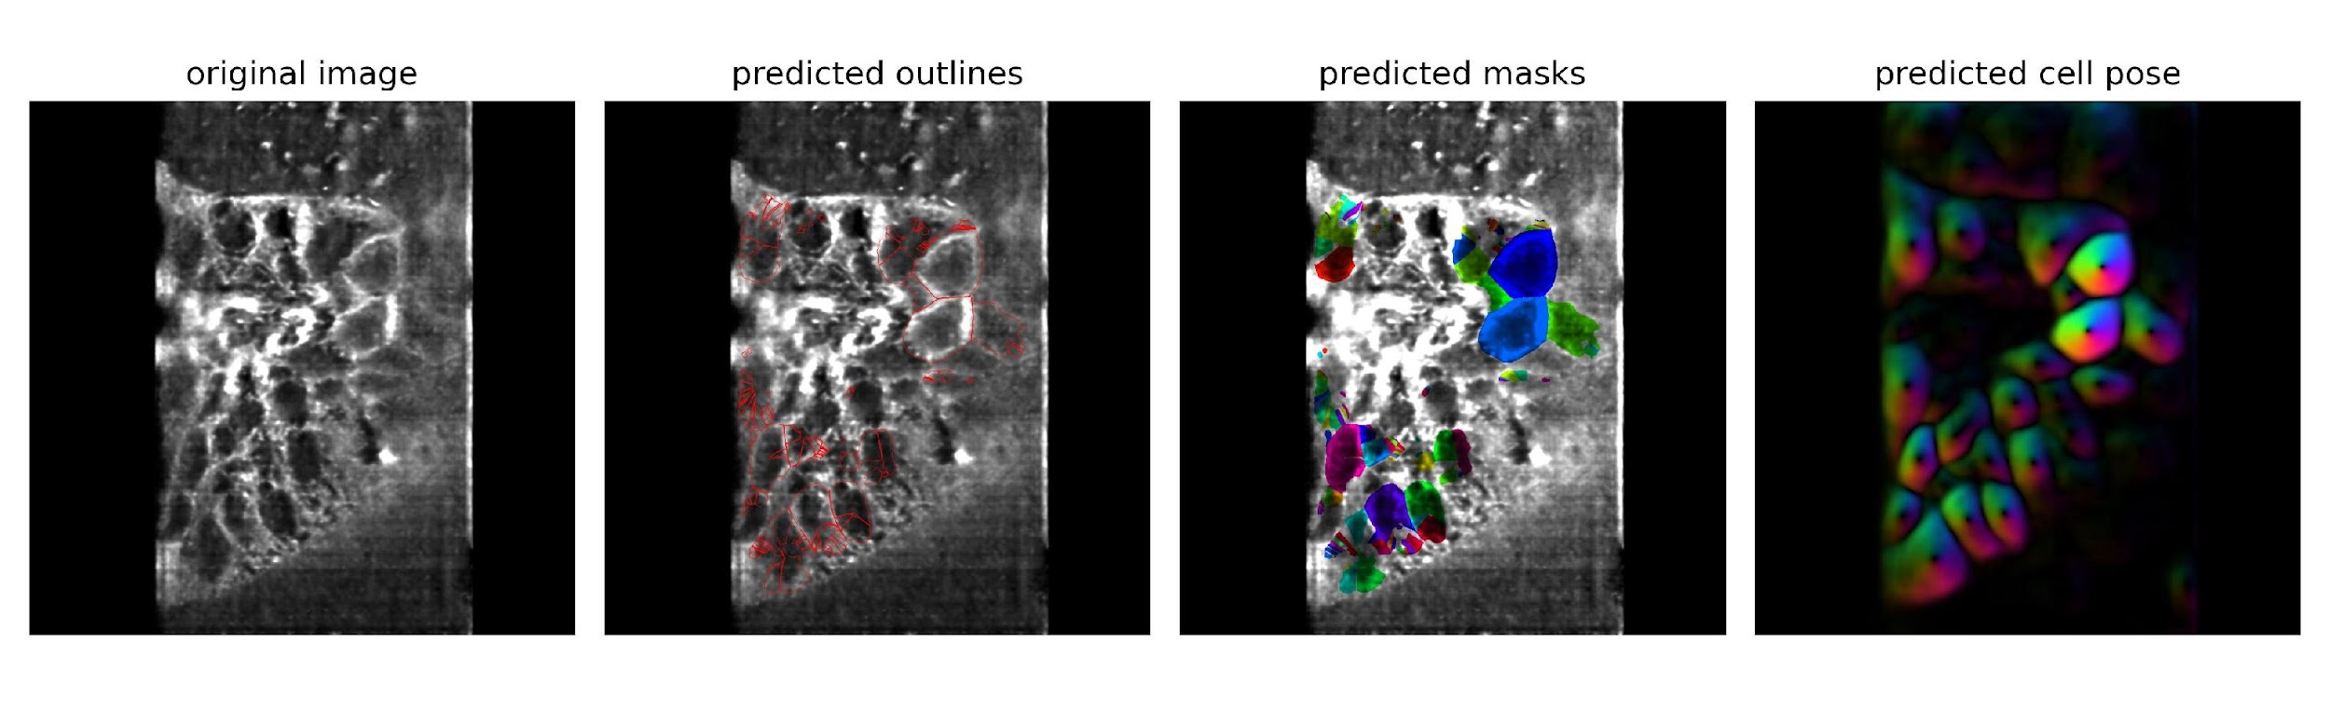
CARE | CellPose
Slice 150
Raw
CARE

Slide 34
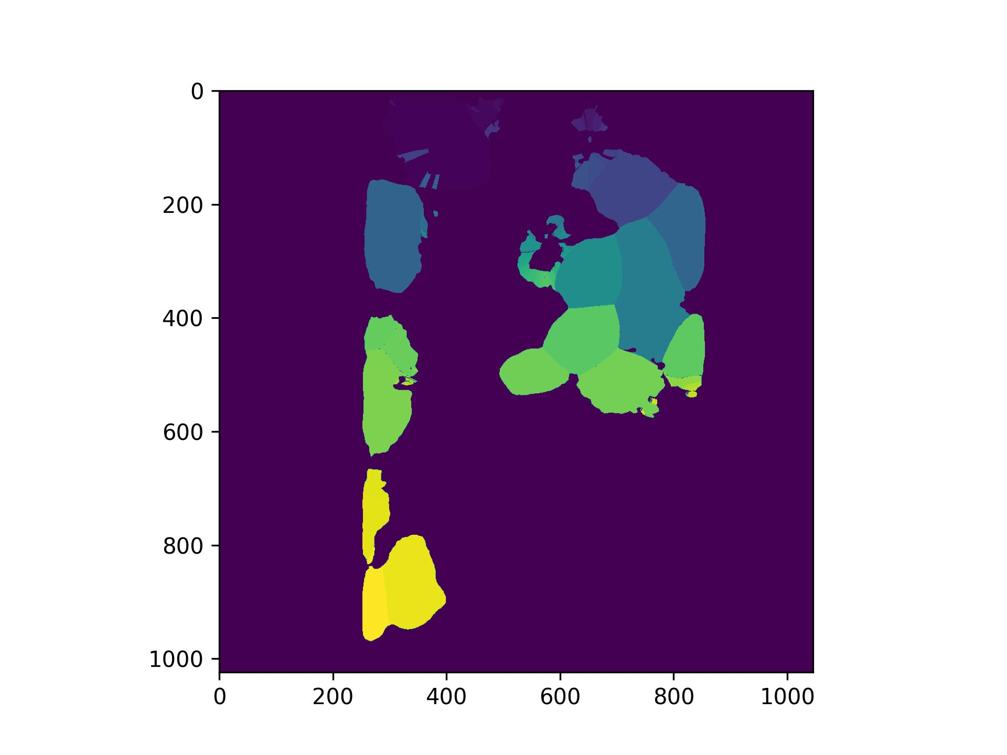
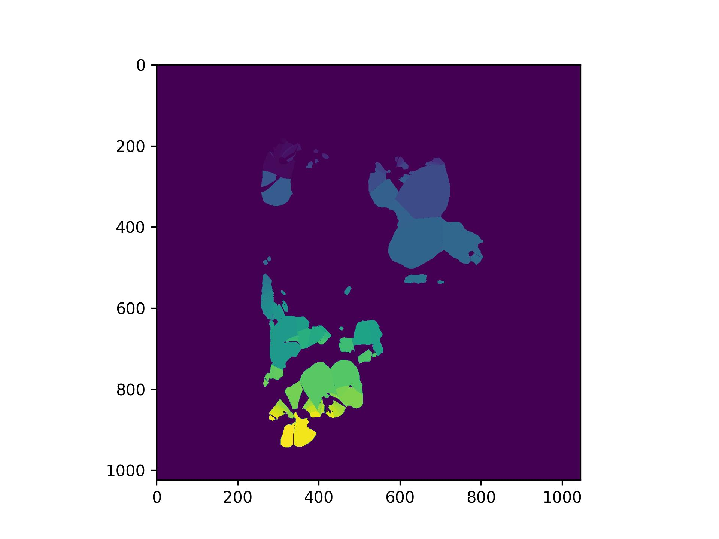
CARE | CellPose
Slice 150
Raw
CARE

Slide 35
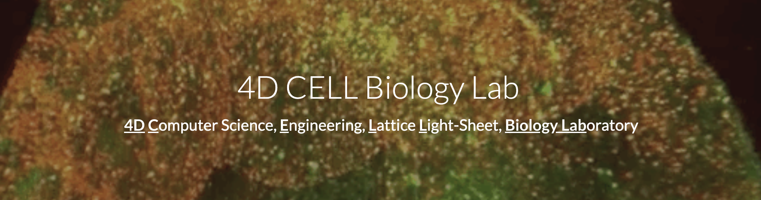
Thank you! You are an amazing team!!!

Slide 36
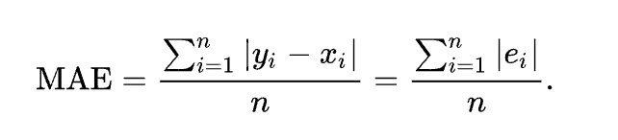
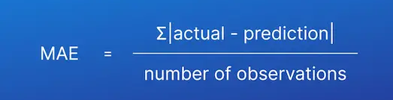
Supplementary
Deep Learning methods are based on:
Mathematical Models
Average Error Across the Model

